Slide 1
BSEN 5250/6250
Lecture 12
Compartmental Models of
Biogeochemical Cycles
Reading: Chapter 13 of Computer Simulation in Biology by
Keen and Spain

Slide 2
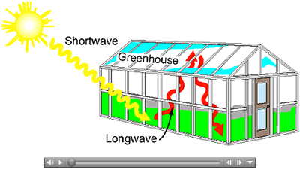
What is the Greenhouse Effect?
https://www.youtube.com/watch?v=sTvqIijqvTg

Slide 3
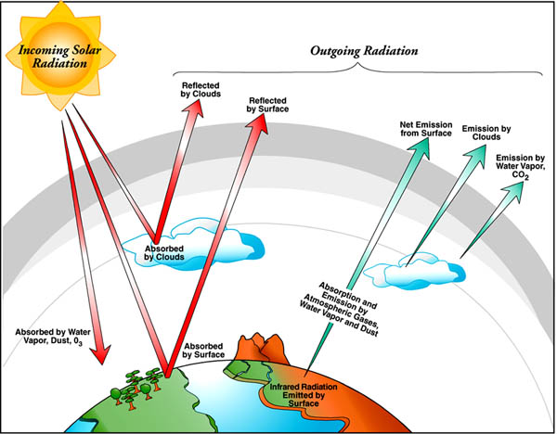
What is the Greenhouse Effect?

Slide 4
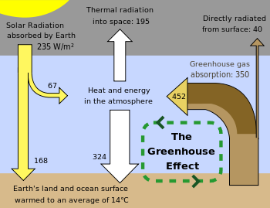
Greenhouse Effect
Shortwave Radiation =➔
Longwave Radiation =➔

Slide 5
Greenhouse Effect
Water vapor (H₂O)
Carbon dioxide (CO₂)
Methane (CH₄)
Nitrous oxide (N₂O)
Ozone (O₃)
Chloroflouocarbons (CFC’s)
Hydroflorocarbons
Clouds!

Slide 6
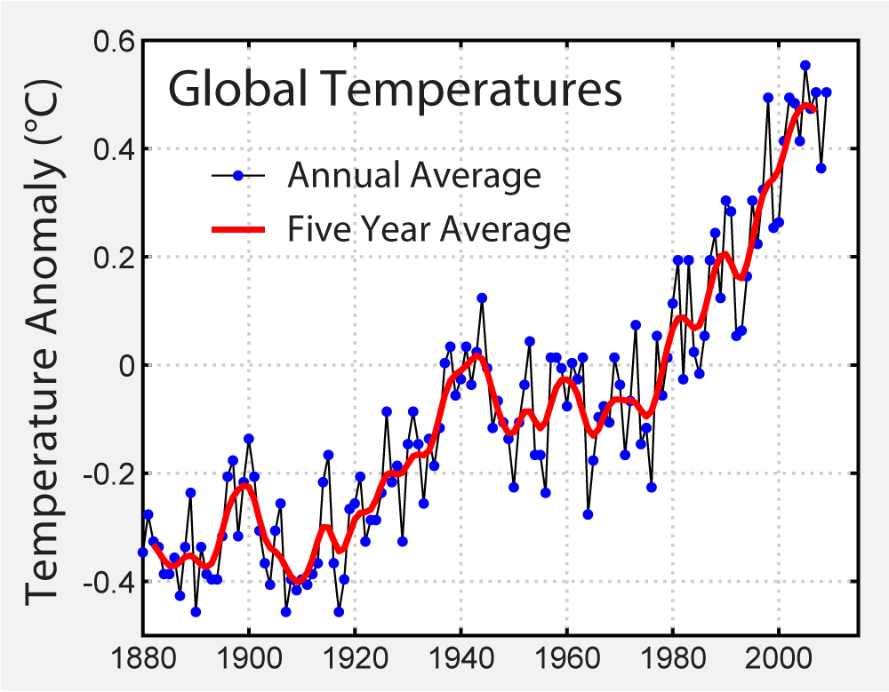
Mean Global Temperature
Increase of 0.5-1.0 F since 1900
Highest temperatures during 2000-2010

Slide 7
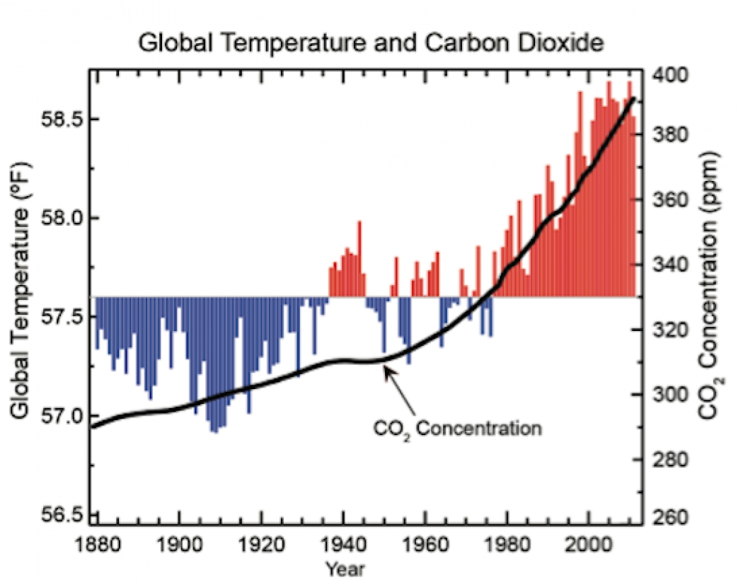
Mean Global Temperature
Current CO₂ level is 407 ppm
https://www.co2.earth/daily-co2

Slide 8
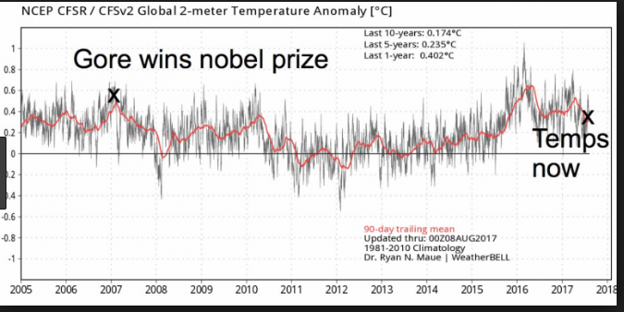
Mean Global Temperature
Increase of 0.5-1.0 F since 1900
Highest temperatures during last 10 years of century

Slide 9
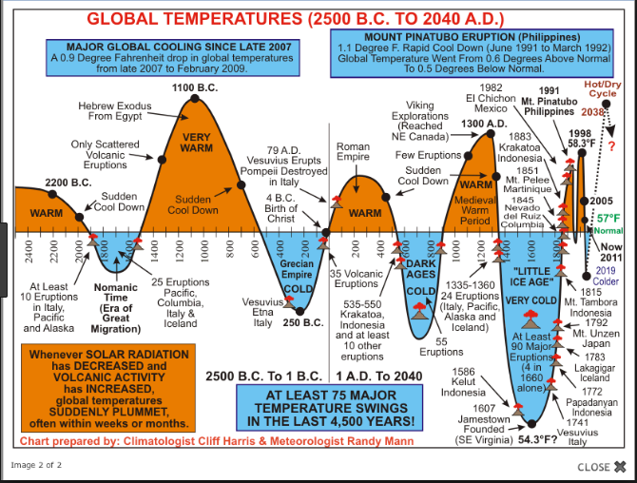

Slide 10
Effects of Increased Temperature
Temperature expected to rise 1-4.5 F in next 50 years and 2-10 F in next 100 years
Evaporation and rainfall will increase
Soil moisture will decline
Intense rain storms will become more frequent
Sea levels may rise as much as 2 feet as polar ice caps melt
Increased temperature will affect ecosystems

Slide 11
What are Greenhouse Gasses?
Greenhouse gasses absorb solar radiation from the earth and reradiate it back to earth. Increase in these gasses cause an increase in energy in the atmosphere
CO₂ – 54%
CFC’s – 21%
Methane – 12%
Ozone – 7%
Nitrous Oxide – 6%

Slide 12
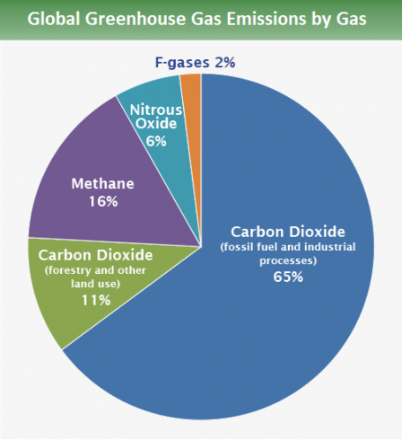

Slide 13
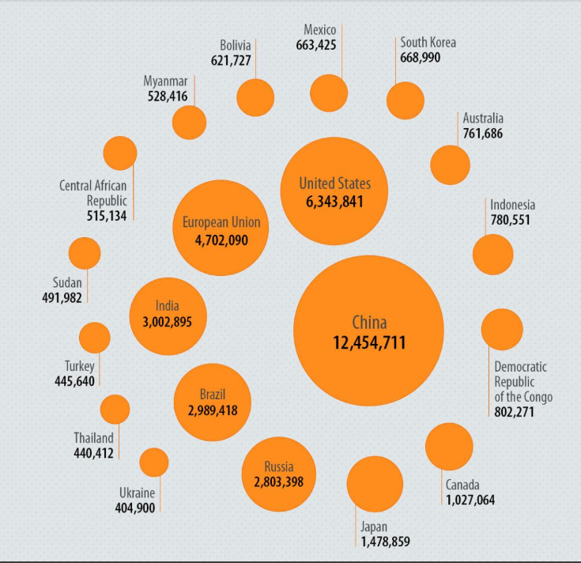
Greenhouse Gas Emission per Capita
In the United States, approximately 6.6 tons (almost 15,000 pounds carbon equivalent) of greenhouse gases are emitted per person every year. And emissions per person have increased about 3.4% between 1990 and 1997. Most of these emissions, about 82%, are from burning fossil fuels to generate electricity and power our cars. The remaining emissions are from methane from wastes in our landfills, raising livestock, natural gas pipelines, and coal, as well as from industrial chemicals and other sources.

Slide 14
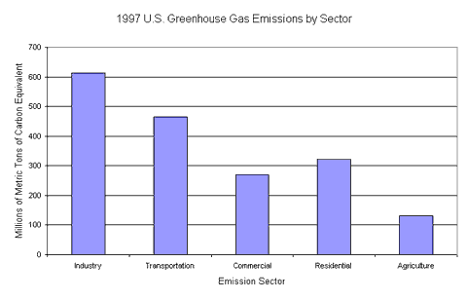

Slide 15
Equilibrium Carbon Cycle for Atmosphere (Gigatons)
Atmosphere N₁ = 700
F₂₁
100
F₁₄
55
F₄₁
110
F₁₂
100
Short-lived Terrestial Biota
Mixed upper ocean layer
F₁₆
53
N₄ = 130
N₂ = 1000
F₆₄
40
F₅₄
15
F₃₂
33.3
F₂₃
33.3
Decomposing OM N₆ = 60
Long-lived biota (wood)
F₆₅
15
N₅ = 700
Deep ocean layer N₃ = 36000
F₁₇
2
F₇₆
2
Soil
N₇ = 1500
Storage = gigatons, flux = gigatons/year

Slide 16
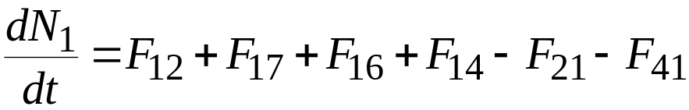
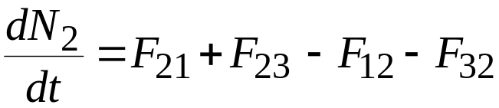
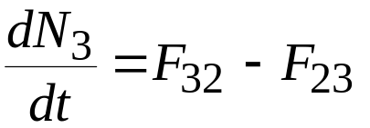
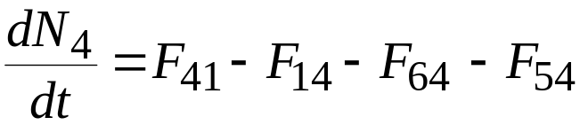
Mass Balance Equations
Atmosphere
Mixed Upper Ocean Layer
Deep Ocean Layer
Short lived terrestrial biota
F = CO₂ flux, GT/year
N = level of CO₂ storage, GT

Slide 17
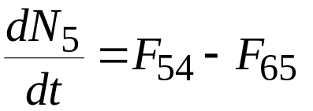
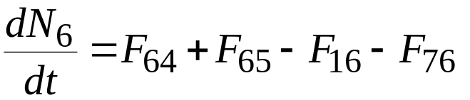
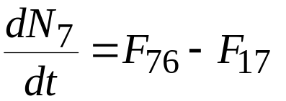
Mass Balance Equations
Long lived biota (wood)
Detritus (deteriorating OM)
Soil
F = CO₂ flux, GT/year
N = level of CO₂ storage, GT

Slide 18
Flux Equations
Assume most fluxes are 1st order
F₂₁ = k₂₁ * N₁ k₂₁ = F₂₁/N₁ = 100/700 = 0.14286 GT/yr
F₃₂ = k₃₂ * N₂ k₃₂ = F₃₂/N₂ = 33.3/1000 = 0.033 GT/yr
F₂₃ = k₂₃ * N₃ k₂₃ = F₂₃/N₃ = 33.3/36000 = 0.000925 GT/yr
F₁₇ = k₁₇ * N₇ k₁₇ = F₁₇/N₇ = 2/1500 = 0.00133 GT/yr
F₁₆ = k₁₆ * N₆ k₁₆ = F₁₆/N₆ = 53/60 = 0.8833 GT/yr
F₁₄ = k₁₄ * N₄ k₁₄ = F₁₄/N₄ = 55/130 = 0.4231 GT/yr
F₆₄ = k₆₄ * N₄ k₆₄ = F₆₄/N₄ = 40/130 = 0.3077 GT/yr
F₇₆ = k₇₆ * N₆ k₇₆ = F₇₆/N₆ = 2/60 = 0.0333 GT/yr
F₅₄ = k₅₄ * N₄ k₅₄ = F₅₄/N₄ = 15/130 = 0.1154 GT/yr
F₆₅ = k₆₅ * N₅ k₆₅ = F₆₅/N₅ = 15/700 = 0.0214 GT/yr

Slide 19
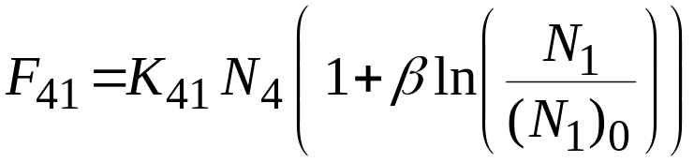
Flux Equations
Non-linear transfer of CO₂ from atmosphere to plants
(N₁)₀ = equilibrium atmospheric CO₂, 700 GT
ß = photosynthesis, 0.1
K₄₁ = 110/130 = 0.846 ⬅=== Sink Limited Flow
N₄ = 130
F₁₂ = N₂ – 900 Rate of CO₂ diffusion from ocean to air

Slide 20
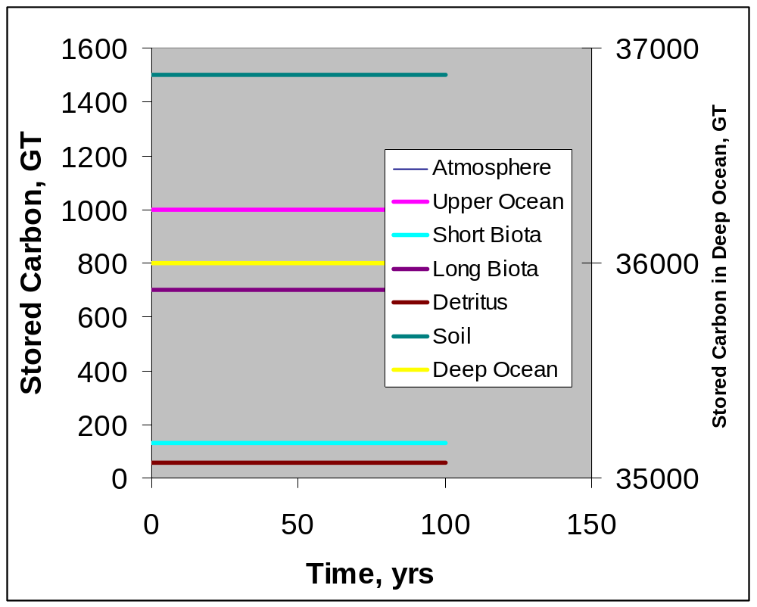
Exercise 13-4: Develop the model

Slide 21
Exercise 13-5: Simulate Carbon Release
Modify the model to simulate a single incident of a massive destruction of forest and release of 10 GT of carbon from the long-lived biota to the atmosphere

Slide 22
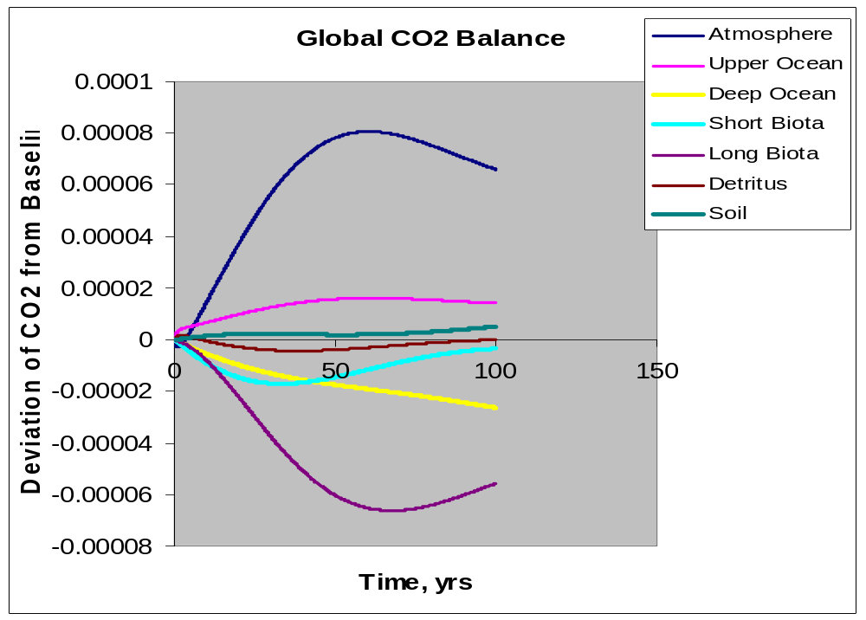

Slide 23
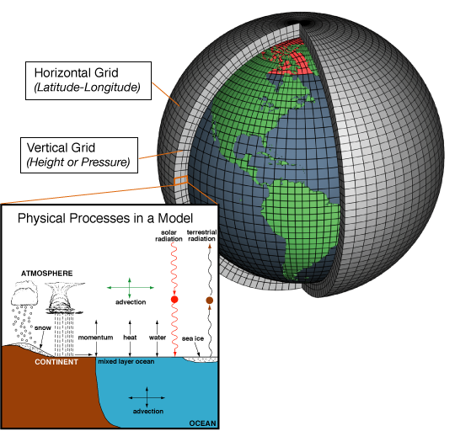
Global Climate Change Models

Slide 24
